Slide 1
Web Service
A Web service is a form of a component that can be used remotely[over Network]
A Web service is any service that is available over the Internet, uses a standardized XML messaging system to exchange the information, and is not tied to any one operating system or programming language.
Web services are the fundamental building blocks over Internet.
A Web service applies SOAP and HTTP protocols to transfer data between Client to Server and Server to Client.

Slide 2
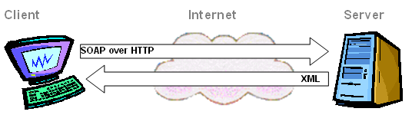
Web Service Mechanism

Slide 3
Web Service Characteristics
The characteristics of Web services are:
Language and platform independence
Self-describing
XML based messaging system
Available over the Internet or private (intranet)

Slide 4
Terminologies Related to Web Services
Following are certain terminologies related to Web services:
SOAP: Simple Object Access Protocol
UDDI:Universal Description, Discovery and Integration
WSDL:Web Services Description Language
DISCO: Discovery File

Slide 5
SOAP
SOAP is a XML based protocol to exchange information between client and server.
This is a Communication Protocol for XML Web Services.
It is a specification that defines the XML format for messages.
Thus the SOAP message is a well formed XML enclosed with SOAP elements.
Reasons for preferring SOAP:
Platform independency
Language independency
XML Based
Based on W3C (World Wide Web Consortium) standard

Slide 6
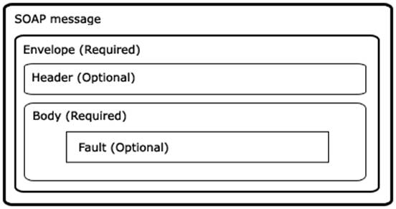
Components of SOAP
Soap Header will contain address of destination to carry request and response.
Soap Body will contain method call info and result of method execution
Soap fault will contain error info

Slide 7
SOAP MESSAGE
Sample SOAP Request
<?xml version='1.0' encoding='UTF-8'?>
<SOAP-ENV:Envelope
xmlns:SOAP-ENV="http://schemas.xmlsoap.org/soap/envelope/"
xmlns:xsi="http://www.w3.org/2001/XMLSchema-instance"
xmlns:xsd="http://www.w3.org/2001/XMLSchema">
<SOAP-ENV:Body>
<ns1:getTemp
xmlns:ns1="urn:xmethods-Temperature"
SOAP-ENV:encodingStyle="http://schemas.xmlsoap.org/soap/encoding/">
<zipcode xsi:type="xsd:string">10016</zipcode>
</ns1:getTemp>
</SOAP-ENV:Body>
</SOAP-ENV:Envelope>

Slide 8
WSDL
WSDL Stands for Web service Description Language.
This describes Web services in a common XML grammar.
It can be used to create proxy objects.
WSDL describes the following data related to Web services: Interface information describing all publicly available functions
Data type information for all message requests and message responses
Binding information about the transport protocol to be used
Address information for locating the specified service

Slide 9
Webservice Classes
.NET Assembly for webservices:
Sytem.web.services
WebService attribute class
WebMethod attribute class
WebService attribute is applied to webservice class
Webmethod attribute is applied to methods inside a webservice class
Note: methods which are not applied with webmethod attribute will not expose to the client.

Slide 10
Webservice Classes
[WebService]
public class Service1 : System.Web.Services.WebService
{
[WebMethod]
public string m1()
{
return "Hello World";
}
public void m2()
{
}
}
Note: Only m1 will be accessible to client app

Slide 11
Webservice Classes
Webservice file extension: .asmx(Active server method extension).
Webservice file should be placed within physical path of webserver/virtual directory. so that webserver can access for providing services to client app
The target of webpage is end-user
The target of webservice is developer

Slide 12
UDDI
UDDI Stands for Universal Description, Discovery, and Integration (UDDI) Service.
UDDI is required when you're building applications that need to dynamically provided services to external business partners
It is a registry for the Web services
You can publish information about your Web services
You can search for required Web services
For more information visit http://www.uddi.org/about.html
It is not compulsory to place webservices in UDDI

Slide 13
DISCO
Once a Web Service has been deployed, potential Client must be able to discover where it is and how it works.
DISCO is a Microsoft® technology for publishing and discovering Web Services.
DISCO (Abbreviated from discovery) is a list of WSDL documents.
DISCO is used to group common Web services together.
DISCO documents are also available in XML format.

Slide 14
PROXY
To access Web method in .NET, proxy class is needed.
When you add a Web Reference, Visual Studio automatically creates a proxy class.
It locally represents a Web Service.
At design time, the proxy class enables you to apply statement completion for the XML Web service methods.
At run time, a call to a method of the proxy object is processed and encoded as a SOAP request message.

Slide 15
Ajax with Webservices
In General JavaScript is not useful for to access server resources.
If the Requirement is accessing server resources from JavaScript it can be achieved through Webservices.
Browser
Javascript
Webserver
Webservice
Resources
[Database]

Slide 16
Key Points about Webservice
Webmethod can not return datareader,it can not be serialized into xml it is possible only dataset.
Webservices support only server authentication connection strings.

